Slide 1


The Data Science House
We BILT
Pamela Brauda Pamela.Brauda@fscj.edu
David Singletary David.Singletary@fscj.edu
Gina Baker S3787129@students.fscj.edu

Slide 2
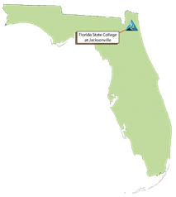
The Neighborhood
Florida State College at Jacksonville

Slide 3
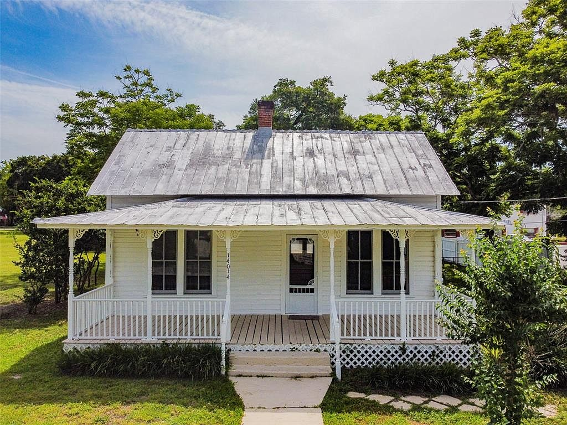
The CIT Program was a 'fixer-upper'
Computer Information Technology A. S. degree
Software Development Track
Web Track
Database Track
Computer Programming Specialist
Database Development Specialist
Information Technology Analysis
Information Technology Support Specialist
Web Development Specialist

Slide 4
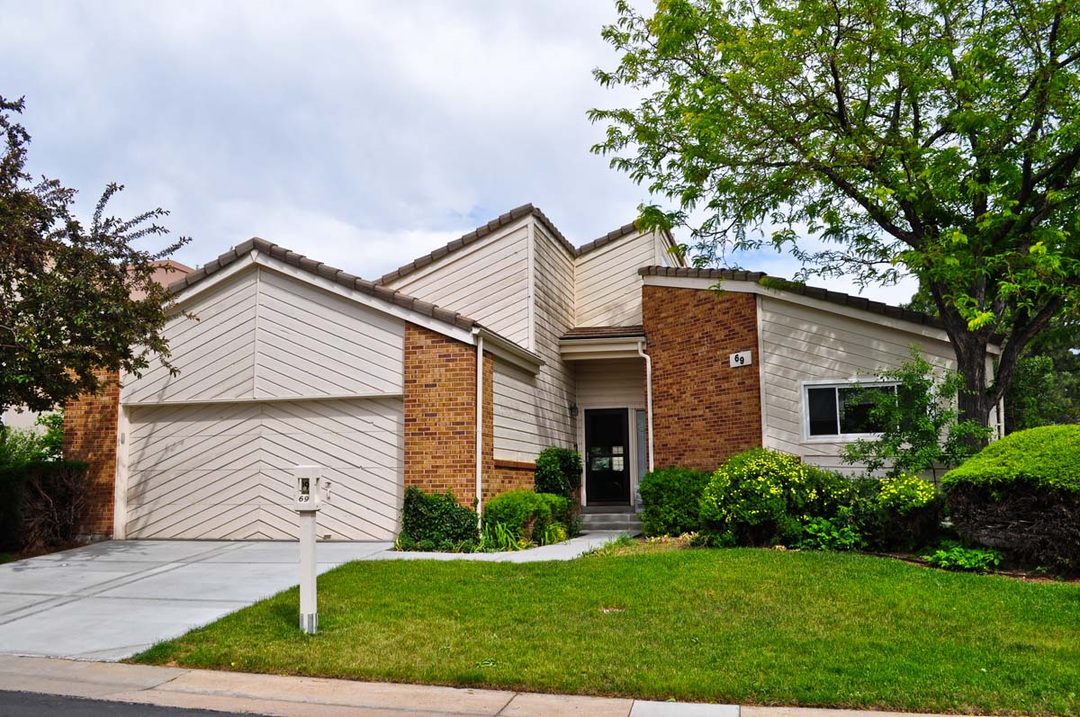
The Dean wants to build a new program
Informatics sounded like something from the 80s

Slide 5
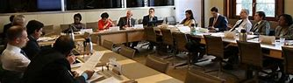
The IT Advisory Committee likes the idea!
They suggest calling it Data Science
Notes:
Florida Blue, CSX, Bank of America, CareerSource Northeast Florida, Locked.com, Converged Communications, Teksystems, ABS Associates, CirrusUp, Business Technology Group, Inc.,
Corporate One Federal Credit Union, Enterprise Integration, Agile Thought, Robert Half Technology, Citizens Property Insurance, Secure Data Consortium, Beeline.com, Inc.

Slide 6

What local industry needs in students:
Python
SAS
R
Big Data / Hadoop
Power BI
Tableau
Security
Notes:
We included 'Technology' in the degree program title to emphasize fundamental/foundation – we're not pretending to train Masters- and Ph.D.-level Data Scientists
There is no state framework for a Data Science Technology degree

Slide 7
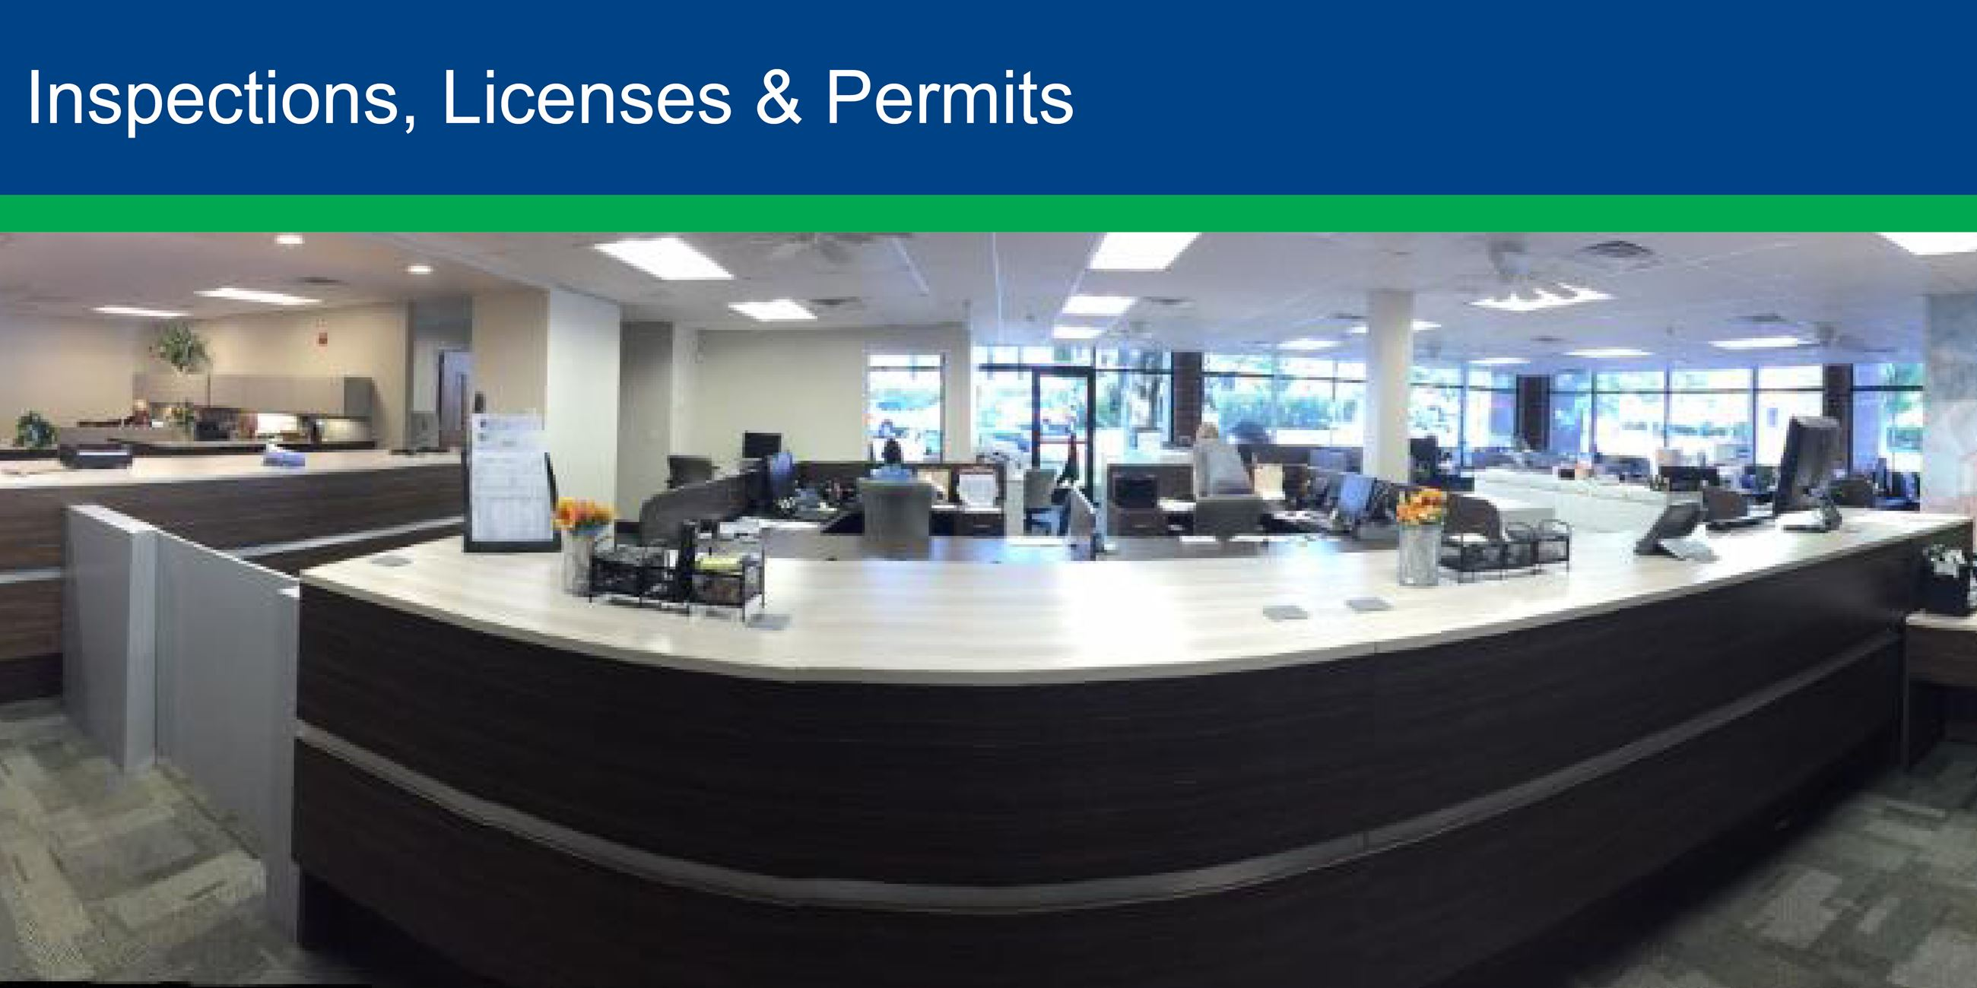
We needed official permission to build
Naturally, we went to the Office of Institutional Effectiveness and Accreditation
SACSCOC – Southern Association of Colleges & Schools Commission on Colleges – Substantive Changes
A new program takes 18 months 😢
A new track only takes 6 months 👍

Slide 8
Planning construction and moving
STRATEGIC MOVE:
Create new electives in the CIT program
Propose a new track – 6-month countdown starts
Start developing the degree framework for the state – 9 months
Use the new electives in the new track!
Use the new track to create a new degree!

Slide 9

DataTEC: Data Science Technician Education & Careers
NSF ATE grant #1902524
$566,953

Slide 10
New furniture added to the old house
Intro to Python Programming
Intro to SAS Programming
Intro to Statistical Programming with R
Intro to Big Data with Hadoop
Data Visualization
Data Warehousing (a rework of a 4000-level BI course)
Intro to Information Tech (Data Science outcome added)
Notes:
New electives added to CIT degree
All have online-ready course shells, funded by the grant

Slide 11
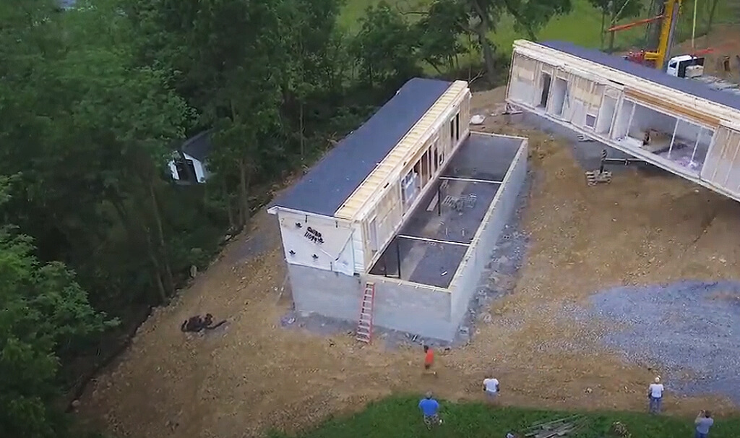
Temporary quarters during construction
Data Science track added to the CIT degree
Electives added to the track

Slide 12

Creating a new degree framework
We took the outcomes from all of the courses we wanted in our program
We grouped them into Standards (suggested 5 to 10)
Polished the outcomes into benchmarks under each standard
The numbering was the biggest challenge

Slide 13

State Framework Approved
Data Science Technology A.S.
https://www.fldoe.org/core/fileparse.php/20569/urlt/1530700100-2324.rtf

Slide 14
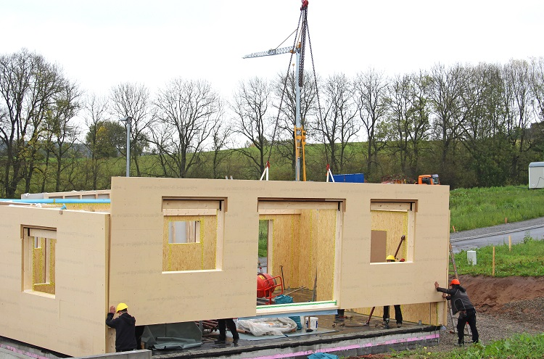
Prefab, modular construction was fast!
The new Data Science Technology A. S. degree proposal sailed through our curriculum process at FSCJ
https://www.fscj.edu/academics/programs/as/2157

Slide 15

More value!
Industry certification preparation
Linux+
Network+
Security+
SAS Base Programmer
Python PCAP
OCA Java
MOS Excel Associate
Tableau Desktop Specialist
Notes:
The grant funds certification exam vouchers for students.

Slide 16

Moving day!
New degree contains all the new electives
Plus courses shared with:
the Computer Information Technology degree
the Networking Systems Technology degree
the IT Security degree
https://catalog.fscj.edu/preview_program.php?catoid=46&poid=8434&returnto=7373

Slide 17
Renting out a room to a neighbor
Two technical certificates (CCCs – college credit certificates)
Data Science Technician Technical Certificate
https://catalog.fscj.edu/preview_program.php?catoid=46&poid=8435
Fintech Technician Technical Certificate
https://catalog.fscj.edu/preview_program.php?catoid=46&poid=8449
Fintech outcomes added to Excel, Python, SAS
Notes:
Leveraging the degree with FinTech
Financial Aid eligible

Slide 18

Dissemination/Training
Summer Working Connections
Virtual & In-person
Textbooks sent to participants
Winter Working Connections
Virtual
WASTEC
HITEC (SLC & Atlanta)
College Professional Development
GitHub repos
Notes:
Sharing with other educators in Professional Development sessions/workshops

Slide 19


SQL Saturday - Jacksonville
Orlando Machine Learning & Data Science Meetup
Big Data Jax Meetup
ODSC – Open Data Science Conference
PyCON – Python.org Conference
r::Studio – R and R studio
WSDS – Women in Statistics & Data Science
ASA-CSP – Conference on Statistical Programming
Github Classroom (7 AM workshop)
Summer Working Connections – Frisco
fintech_devcon
ATE – PI
HITEC
Q-con
SAS Explore
Alteryx Inspire & SparkED

Slide 20

2nd No-cost Extension = 5th year

Slide 21

It's time to remodel
Fintech API outcomes
Git and github used in courses
Jupyter notebook and Google Colab in Python
Posit in Statistical Programming with R
Looking at Alteryx for the Big Data course – Hadoop is getting old
Java needs to move from version 8 to version 17
SAS moves to the cloud with SAS Viya
Network+ course updated for Cloud
Notes:
Course content needs updating for new technologies

Slide 22
